Slide 1
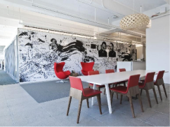

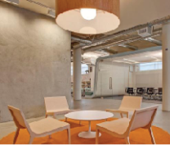
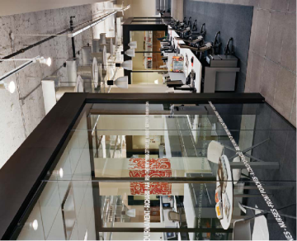


C team
- Jim, Cho, Tom, Lina, Missy
2 Week presentation
Qualcomm Institute

Slide 2
2 week presentation
CONTENTS
C team
Sequence
Diagram
ER
Diagram
Web
Client
Application
Qualcomm Institute

Slide 3
Sequence Diagram
C team
Qualcomm Institute
Notes:
지난 발표에 해서 change point에 대해서

Slide 4
Change point of Sequence Diagram
C team
Delete duplicate information
Change authentication method in forgotten password situation
Change expression
Notes:
비밀번호 변경 방법이 이메일 인증에서 인증 코드로 바뀜
영어 표현 변경
중복 설명 제거
어떻게 변했는지 확인해 보자 (인증 코드 사용하는것으로 바꼈다)

Slide 5
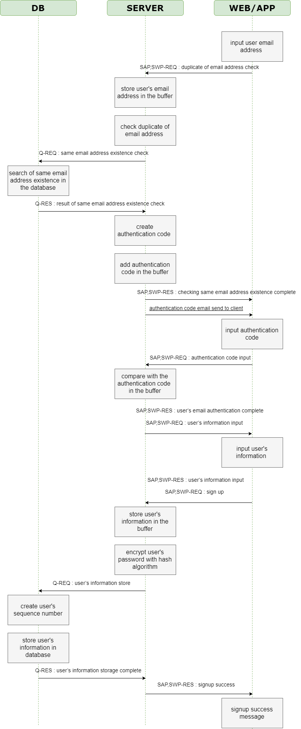
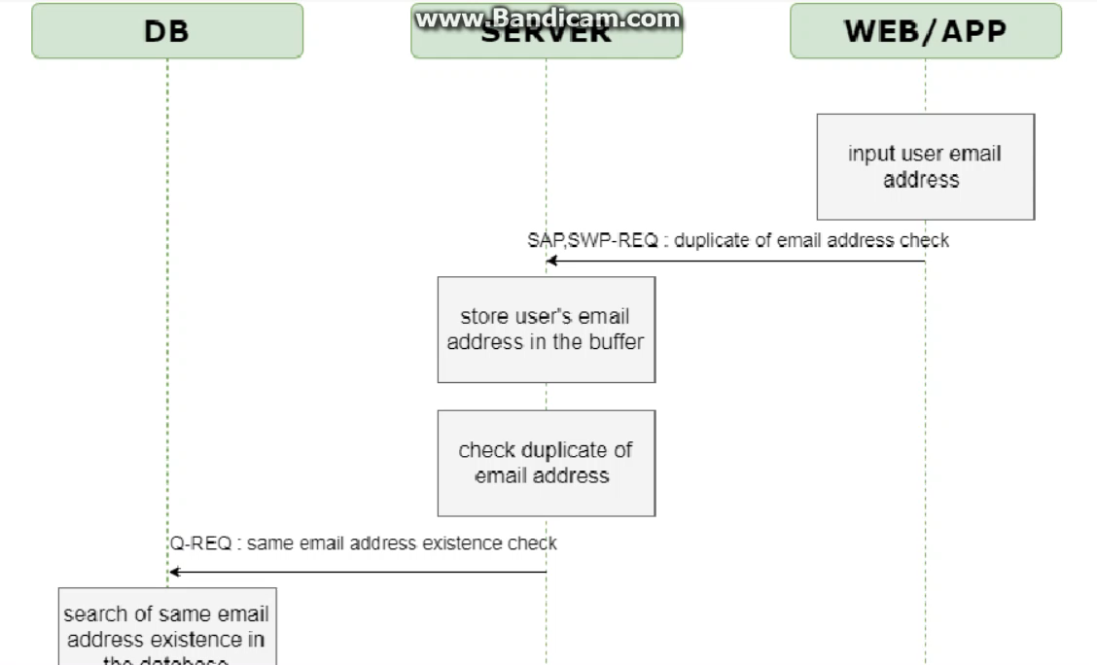
Registration Sequence Diagram
C team

Slide 6
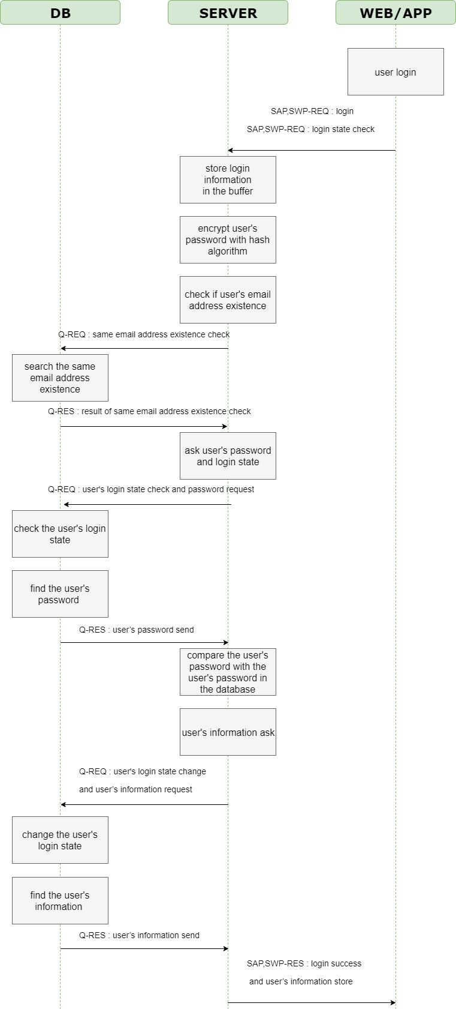
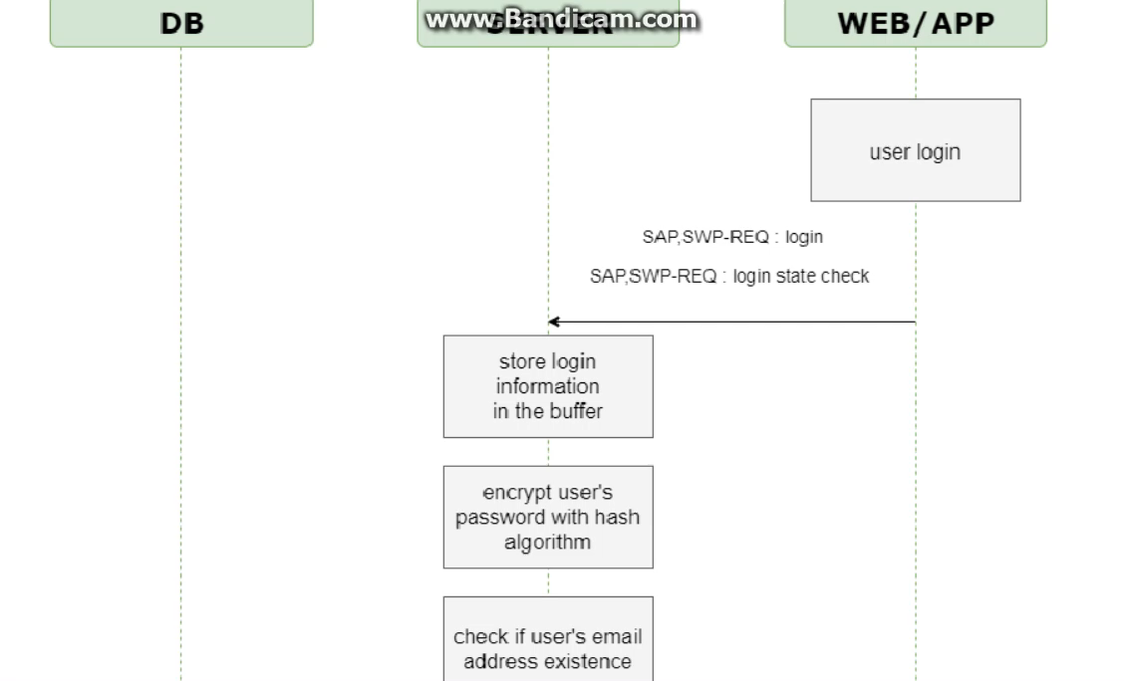
Sign-in Sequence Diagram
C team

Slide 7
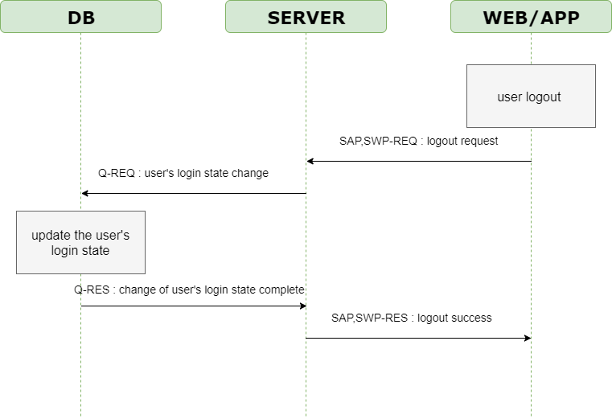
Sign-out Sequence Diagram
C team

Slide 8
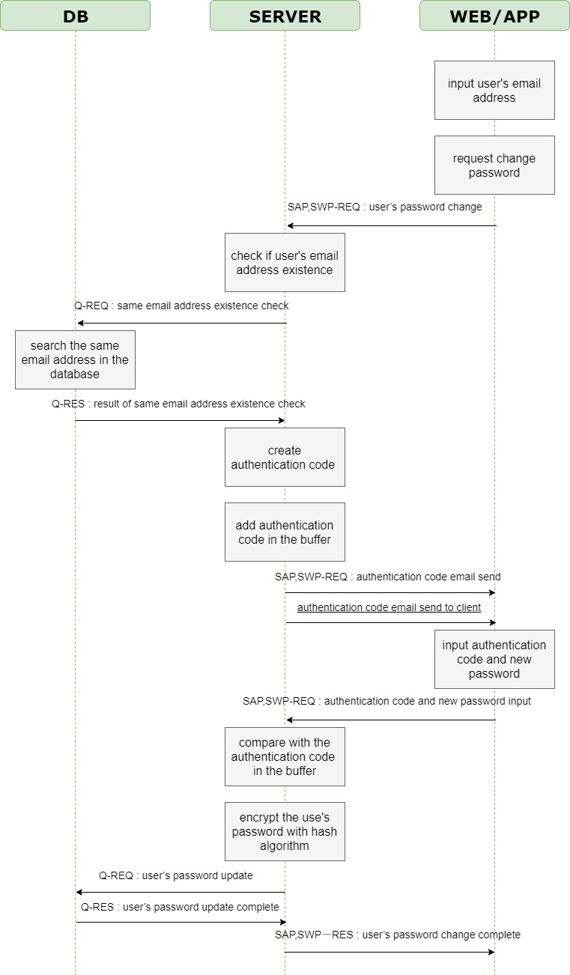
Forgotten password Sequence Diagram
C team
Notes:
- There are not many changes. It is similar to last meeting.

Slide 9
ER Diagram
C team
Qualcomm Institute

Slide 10
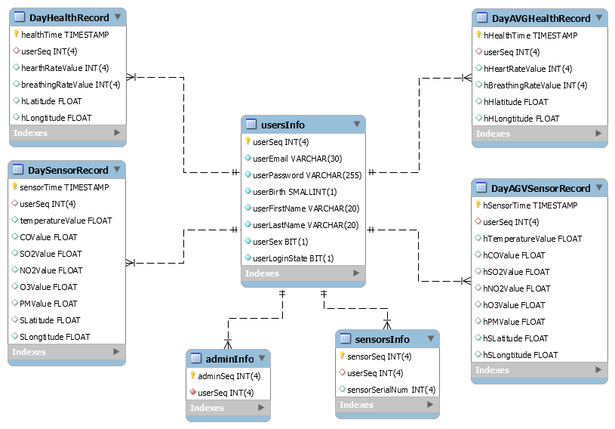
ER Diagram
C team
Notes:
To prevent duplicate logins
After a day, we will average this record and save it.
This table has an average daily record.

Slide 11
Web Client
C team
Qualcomm Institute

Slide 12
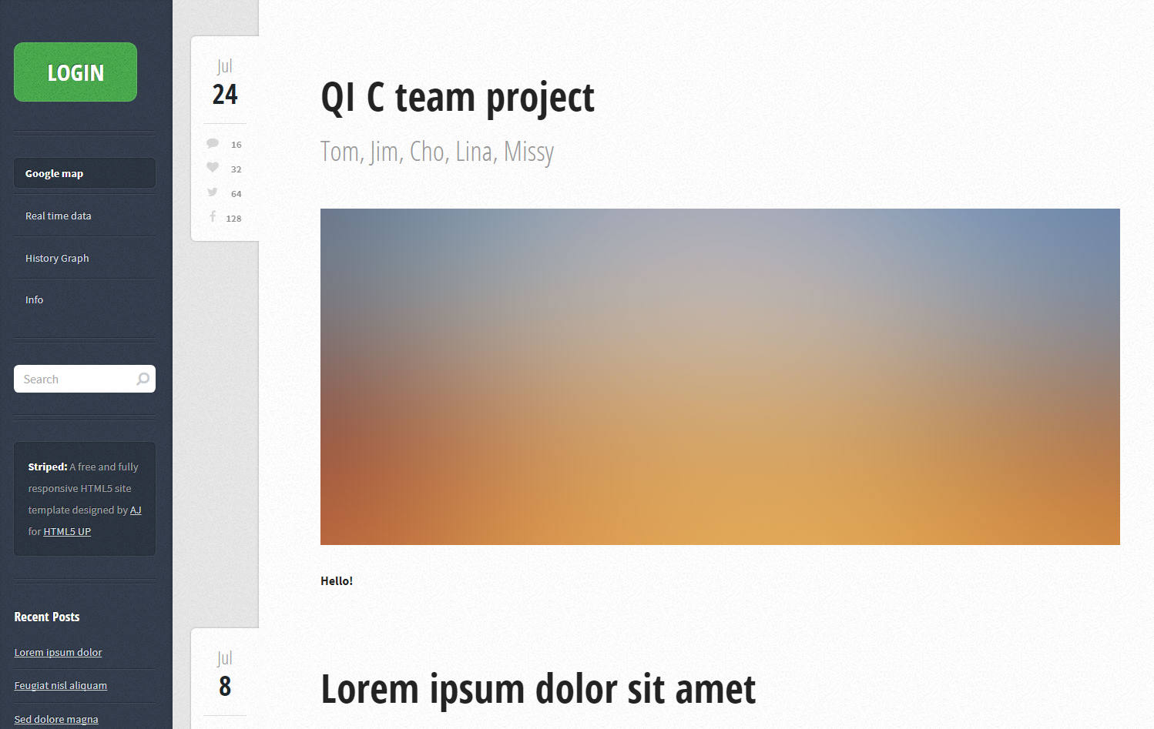
Web client - template
C team
Notes:
- You can see easy at a glance

Slide 13
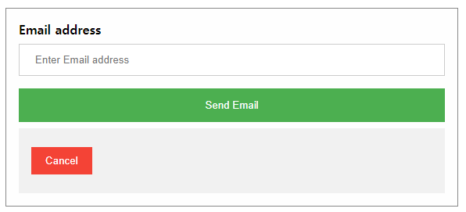
Web client – function(1) Sign up
C team
Before input the user’s information
Notes:
- we have not done it yet

Slide 14
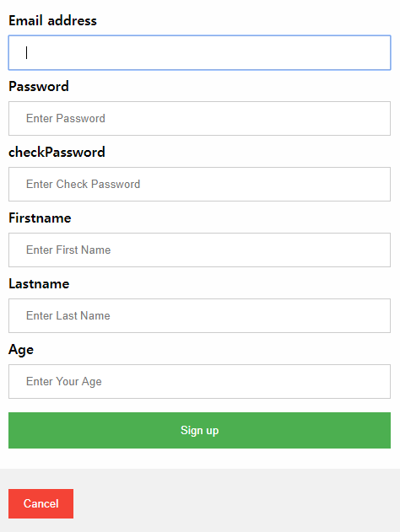
Web client – function(1) Sign up
C team
Encrypt with hash algorithm
Check password
Notes:
If the two are different, a message says the wrong password.

Slide 15
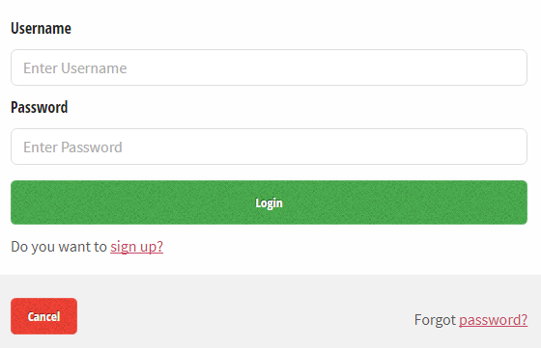
Web client – function(2) Login
C team
- Check correct password
Notes:
- Let's see how it works

Slide 16
Web client
C team
Web Client
Notes:
- Let's see how it works

Slide 17
Application UI
C team
Qualcomm Institute

Slide 18
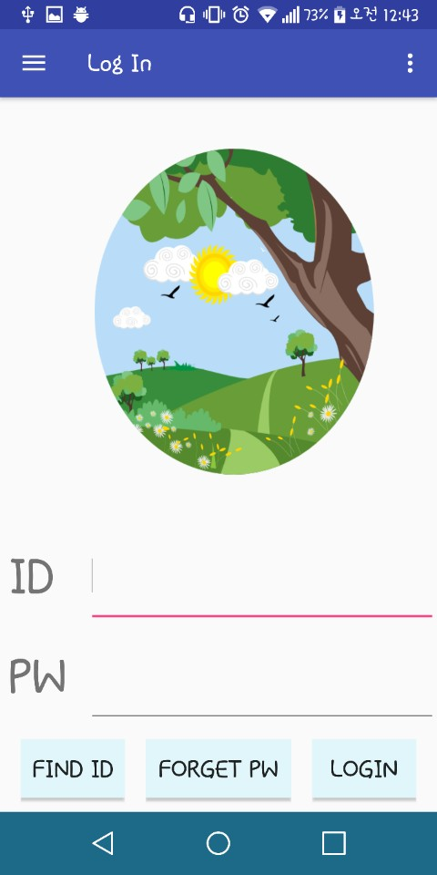
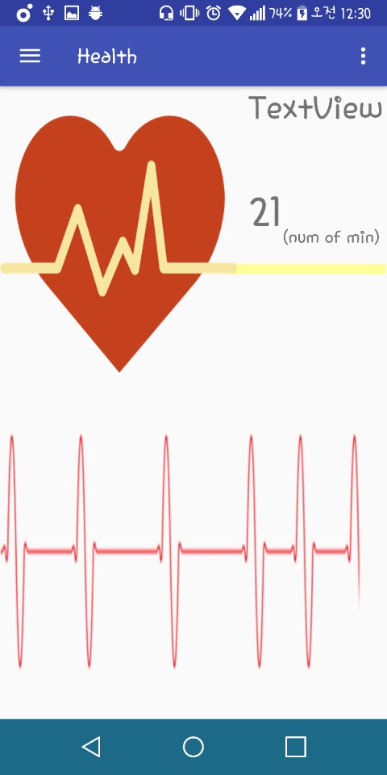
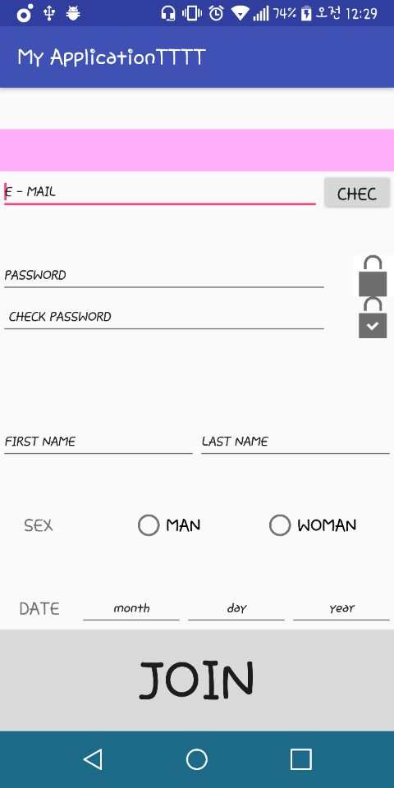
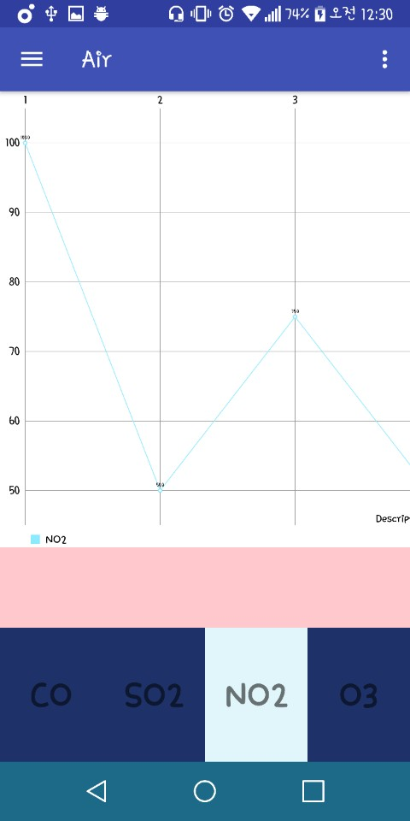
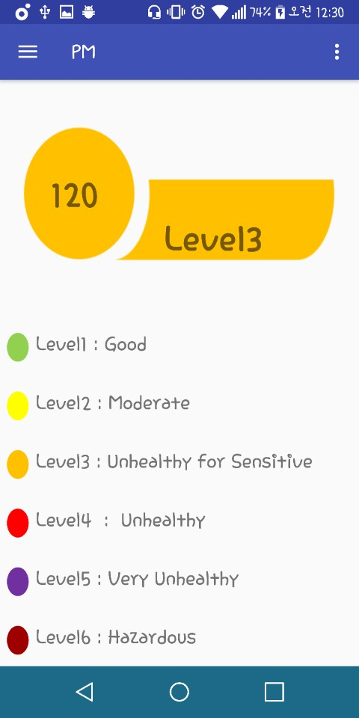
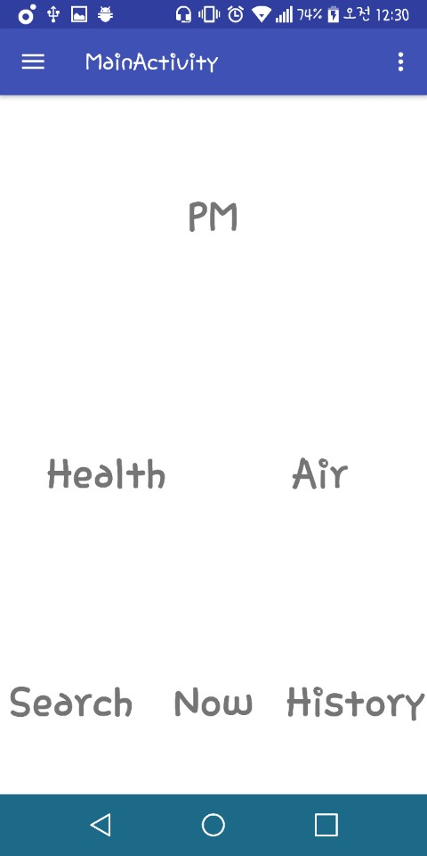
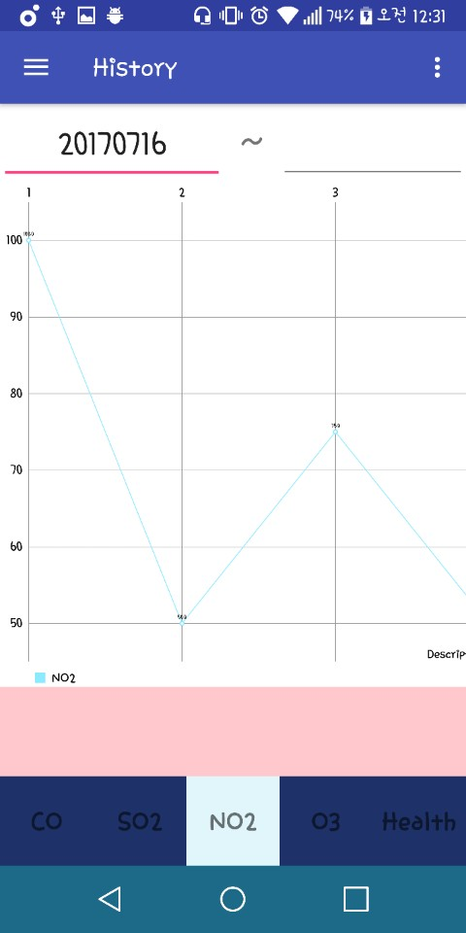
1 Week presentation
Application UI
C team

Slide 19
Thank you
Qualcomm Institute

